Slide 1

Exploring Advanced Attacks: Understanding and Investigating the Threat Landscape
Ashu Sharma

Slide 2

Agenda
Introduction
Non-PE file-based attacks and their increasing prevalence
Various Non-PeFiles format and their Analysis
Investigation: Advanced attacks involving non-PE files
Example attacks scenarios
PDF as attachment
MS word document
Recommendations
Detection and Mitigation Strategies
References
Q&A

Slide 3
Introduction

Slide 4

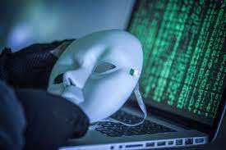
Non-PE file-based attacks
As the threat landscape continues to evolve, cybercriminals are constantly finding two things
exploit vulnerabilities
evade detection.
Did you know that 91% of successful data breaches started with a spear phishing attack
https://www.knowbe4.com/roe-phishing-security-test-ga?utm_term=%2Bspear%20%2Bphishing&utm_campaign=Google_NonBrand_Phishing_Security_Search_ROE&utm_source=google&utm_medium=ppc&matchtype=b&network=g&device=c&adposition=&keyword=%2Bspear%20%2Bphishing&gad=1&gclid=CjwKCAjwvdajBhBEEiwAeMh1Ux7D_VE7_fjsuAQhoXQ6gk56N48mRDNKL7yLMhhcIJWVrfXmRCzE1BoCobcQAvD_BwE

Slide 5
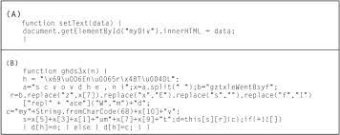
Increasing Prevalence of Non-PE files
Polymorphic Techniques: Attackers often use non-PE files as carriers for polymorphic malware.
Embedded Scripts: Non-PE files, including HTML, JavaScript, or VBScript files, can contain embedded scripts that are executed by compatible applications or web browsers.
Fileless Execution: Non-PE file-based attacks often employ fileless execution techniques. By utilizing legitimate system tools, such as PowerShell, attackers can execute malicious code directly in memory without relying on traditional executable files.
Social Engineering and Phishing: Attackers capitalize on human vulnerabilities by crafting convincing non-PE file-based lures. For instance, they may send phishing emails with seemingly harmless attachments, such as PDF invoices or Office documents.
Notes:
Attackers utilize non-PE files to evade detection and bypass security measures through various techniques, exploiting the unique characteristics of these file formats. Here are some key methods they employ:

Slide 6
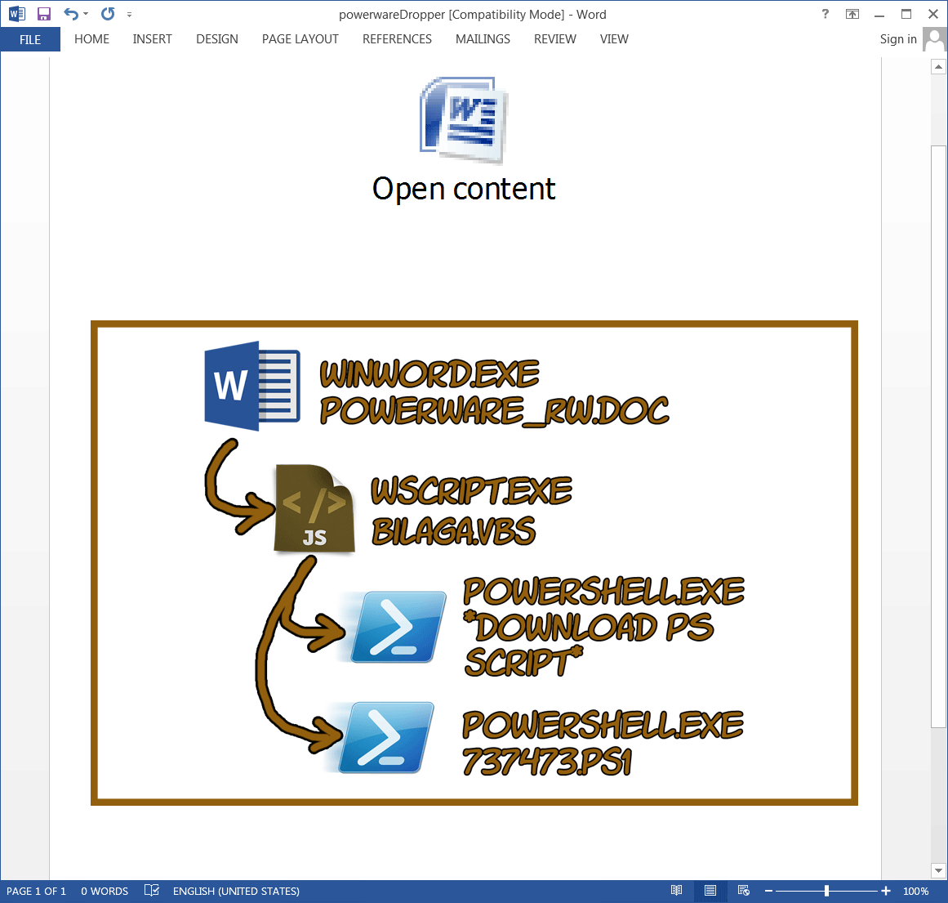
Increasing Prevalence of Non-PE files
Polymorphic Techniques: Attackers often use non-PE files as carriers for polymorphic malware.
Embedded Scripts: Non-PE files, including HTML, JavaScript, or VBScript files, can contain embedded scripts that are executed by compatible applications or web browsers.
Fileless Execution: Non-PE file-based attacks often employ fileless execution techniques. By utilizing legitimate system tools, such as PowerShell, attackers can execute malicious code directly in memory without relying on traditional executable files.
Social Engineering and Phishing: Attackers capitalize on human vulnerabilities by crafting convincing non-PE file-based lures. For instance, they may send phishing emails with seemingly harmless attachments, such as PDF invoices or Office documents.
Notes:
Attackers utilize non-PE files to evade detection and bypass security measures through various techniques, exploiting the unique characteristics of these file formats. Here are some key methods they employ:

Slide 7
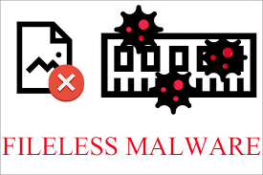
Increasing Prevalence of Non-PE files
Polymorphic Techniques: Attackers often use non-PE files as carriers for polymorphic malware.
Embedded Scripts: Non-PE files, including HTML, JavaScript, or VBScript files, can contain embedded scripts that are executed by compatible applications or web browsers.
Fileless Execution: Non-PE file-based attacks often employ fileless execution techniques. By utilizing legitimate system tools, such as PowerShell, attackers can execute malicious code directly in memory without relying on traditional executable files.
Social Engineering and Phishing: Attackers capitalize on human vulnerabilities by crafting convincing non-PE file-based lures. For instance, they may send phishing emails with seemingly harmless attachments, such as PDF invoices or Office documents.
Notes:
Attackers utilize non-PE files to evade detection and bypass security measures through various techniques, exploiting the unique characteristics of these file formats. Here are some key methods they employ:

Slide 8
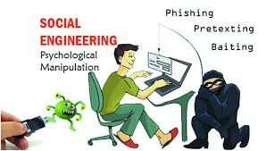
Increasing Prevalence of Non-PE files
Polymorphic Techniques: Attackers often use non-PE files as carriers for polymorphic malware.
Embedded Scripts: Non-PE files, including HTML, JavaScript, or VBScript files, can contain embedded scripts that are executed by compatible applications or web browsers.
Fileless Execution: Non-PE file-based attacks often employ fileless execution techniques. By utilizing legitimate system tools, such as PowerShell, attackers can execute malicious code directly in memory without relying on traditional executable files.
Social Engineering and Phishing: Attackers capitalize on human vulnerabilities by crafting convincing non-PE file-based lures. For instance, they may send phishing emails with seemingly harmless attachments, such as PDF invoices or Office documents.
Notes:
Attackers utilize non-PE files to evade detection and bypass security measures through various techniques, exploiting the unique characteristics of these file formats. Here are some key methods they employ:

Slide 9
Various Non-PeFiles format and their Analysis

Slide 10
Introduction to malicious documents
An attack vector frequently used by malicious agents is the distribution of the malicious payload embedded in an office application document that enjoys a high market share (eg Microsoft Word, Microsoft Excel, Microsoft PowerPoint, RTF, Adobe PDF). . This malicious document is sent as an attachment to an email as part of a phishing campaign.
In order to proceed with the analysis of these malicious documents, the analyst must first know the structure of these documents. This allows you to understand how an attacker can embed code or malware in them, as well as understanding common packaging and obfuscation techniques.
I'm going to do a little introduction to the following types of documents / scripts, focusing on pdf documents
Powershell.
HTA files.
Microsoft Office OLE2 and OOXML.
MSG Files
RTF files.
PDF Files.
Notes:
An attack vector frequently used by malicious agents is the distribution of the malicious payload embedded in an office application document that enjoys a high market share (eg Microsoft Word, Microsoft Excel, Microsoft PowerPoint, RTF, Adobe PDF). .
This malicious document is sent as an attachment to an email as part of a phishing campaign.
In order to proceed with the analysis of these malicious documents, the analyst must first know the structure of these documents.
This allows you to understand how an attacker can embed code or malware in them, as well as understanding common packaging and obfuscation techniques.
I'm going to do a little introduction to the following types of documents / scripts, focusing on pdf documents

Slide 11
Investigation: Advanced attacks involving non-PE files

Slide 12

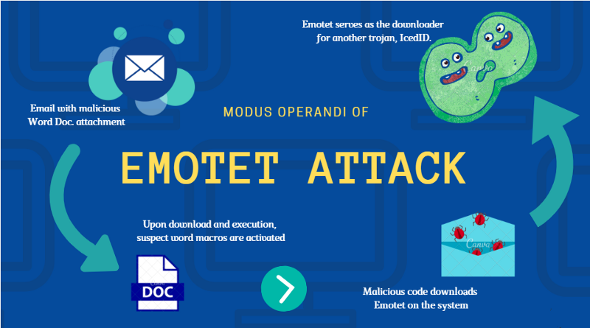
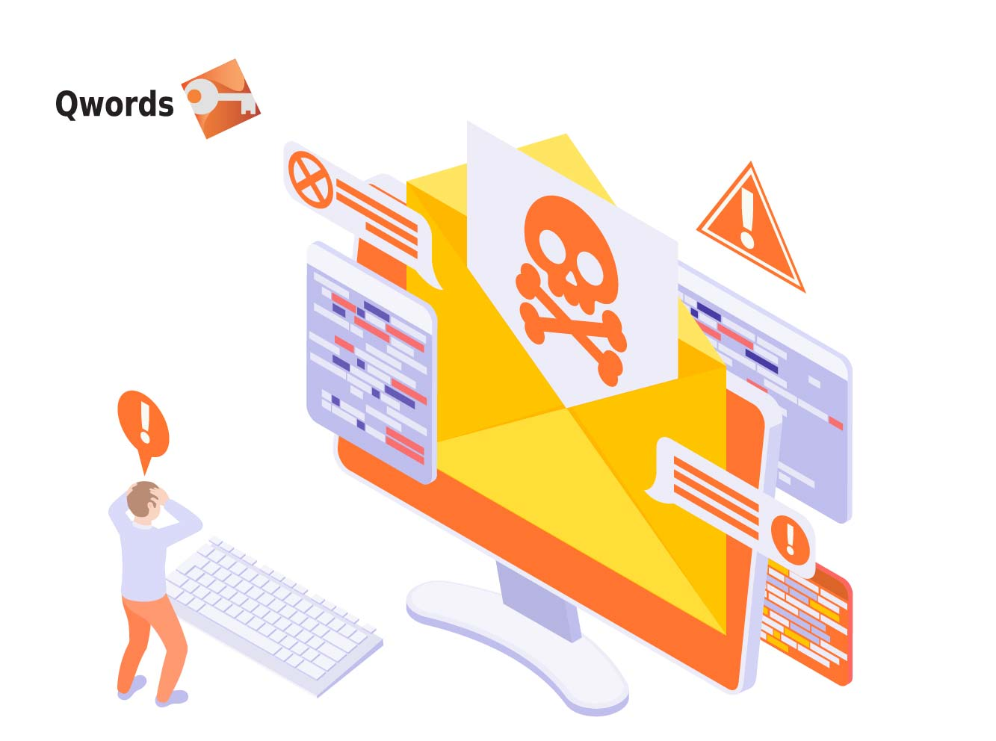

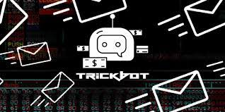


Non-Pe Files used in Attack Vectors

Slide 13
Technical Analysis

Slide 14
Technical Analysis (Static Analysis)
Qbot initial attack vector which involves nonPe files with Pdf File as an email Attachment
Emotet attack vector with word file as an email attachment
Tool Used:
PDF Stream Dumper https://github.com/dzzie/pdfstreamdumper
Ole tools https://github.com/decalage2/oletools
Notepad++ https://notepad-plus-plus.org/downloads/
Notepad (ASCII editor)

Slide 15
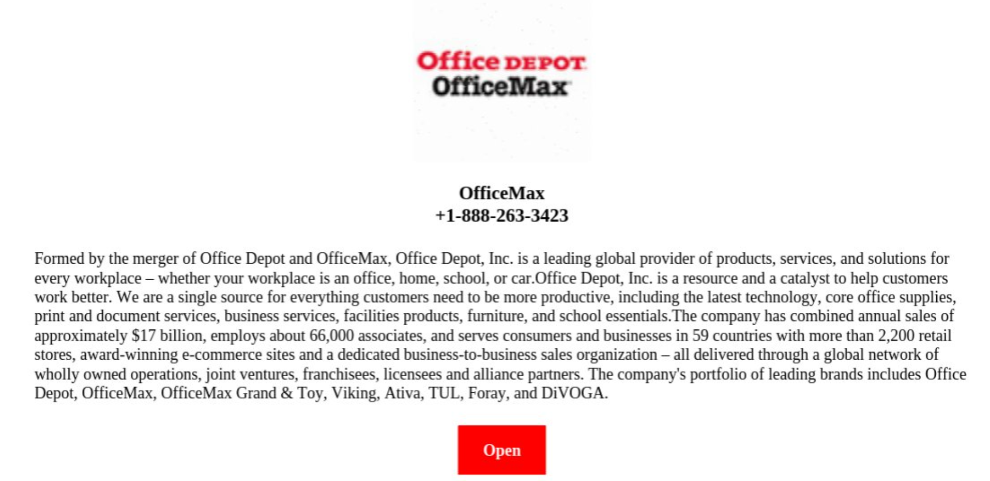
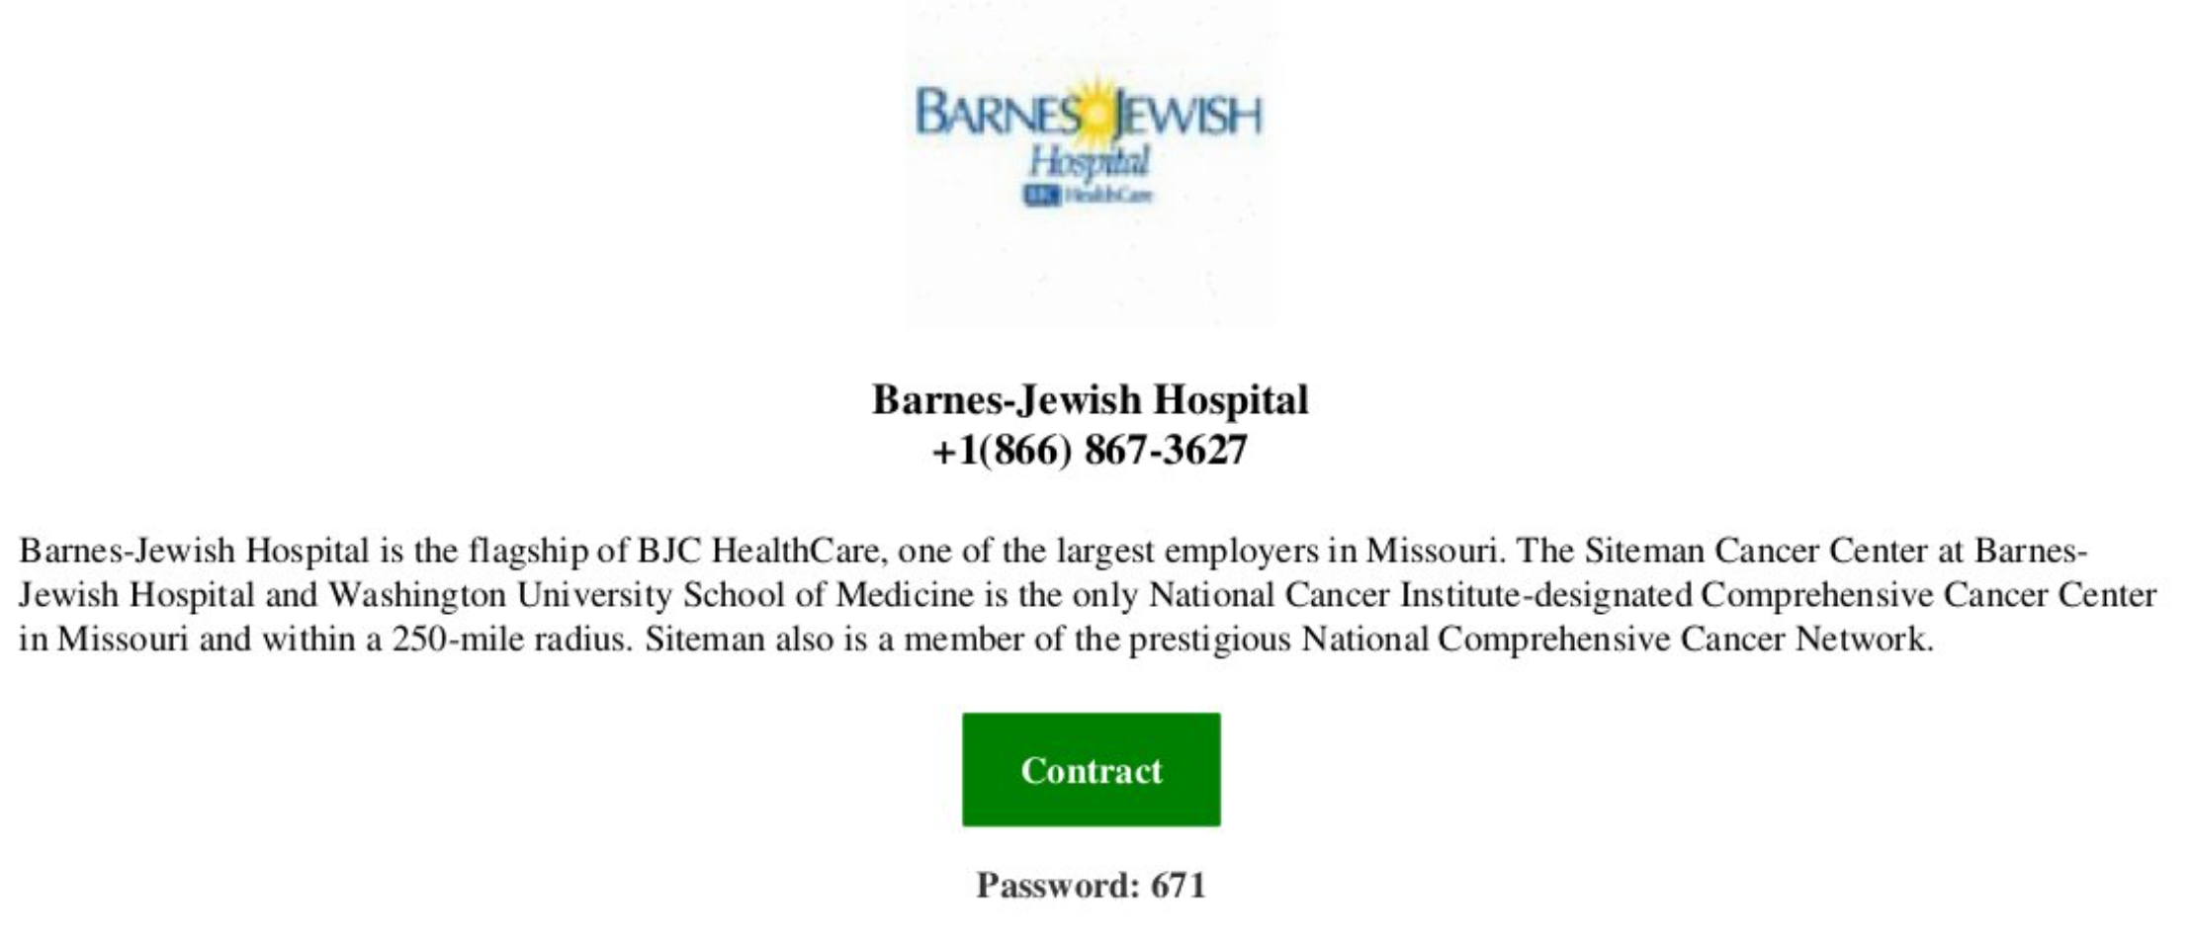
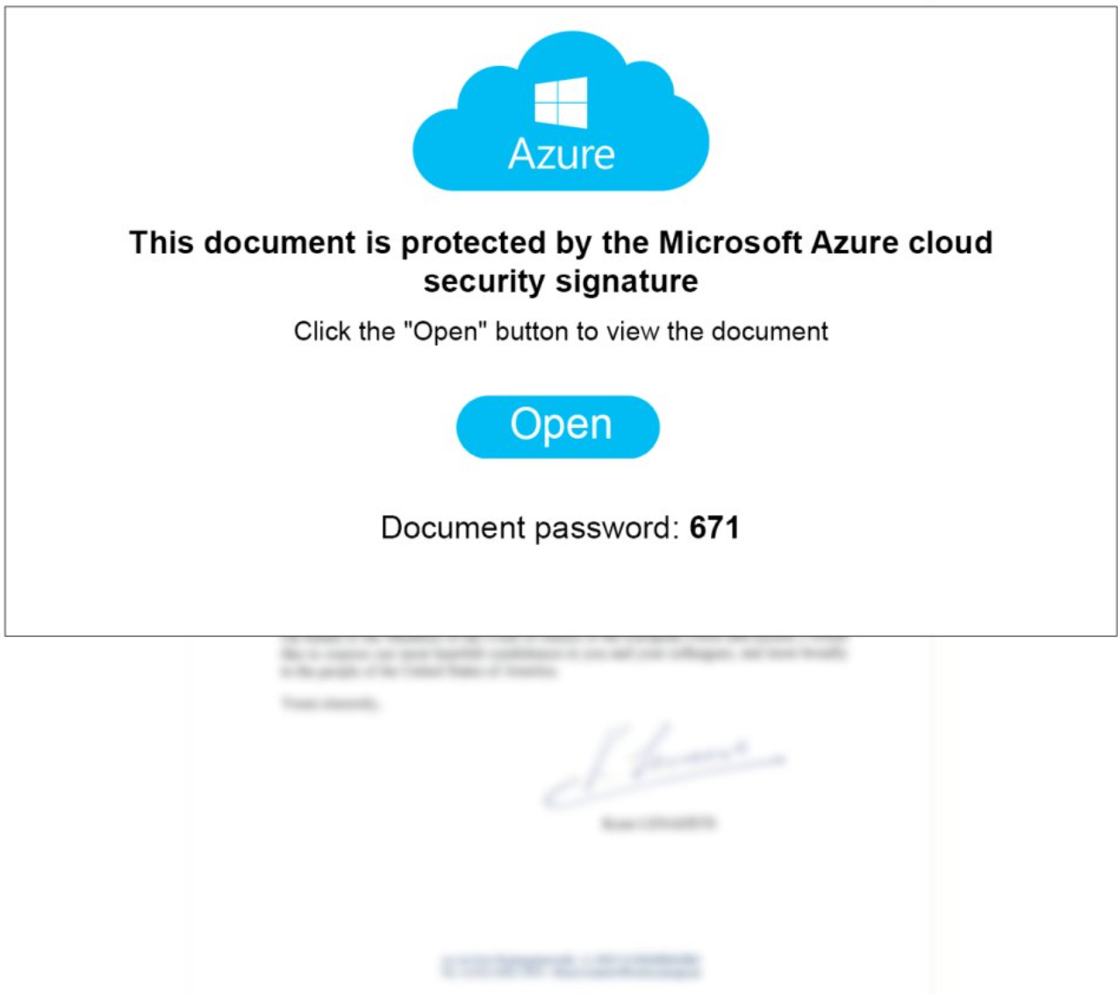
Method of infection and propagation of Qbot

Slide 16
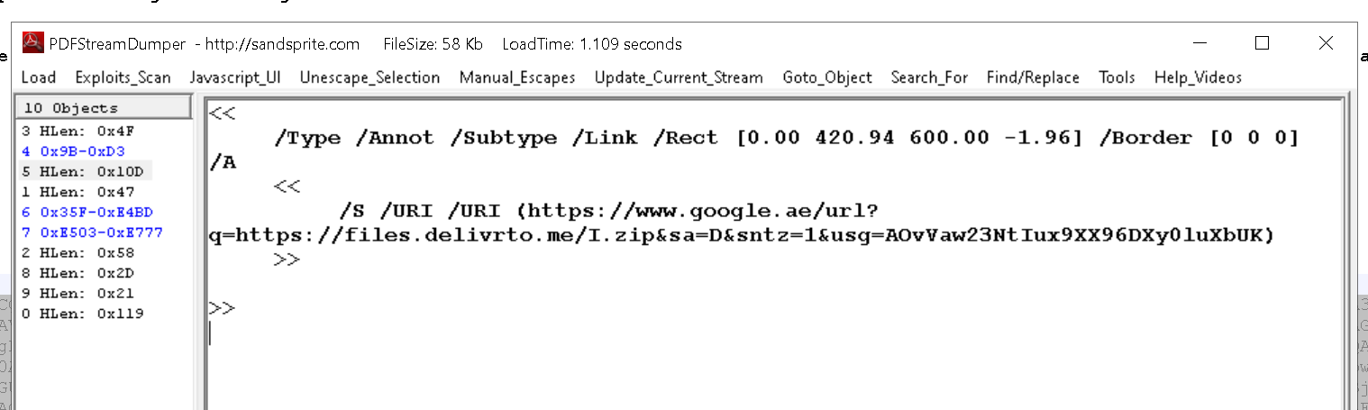
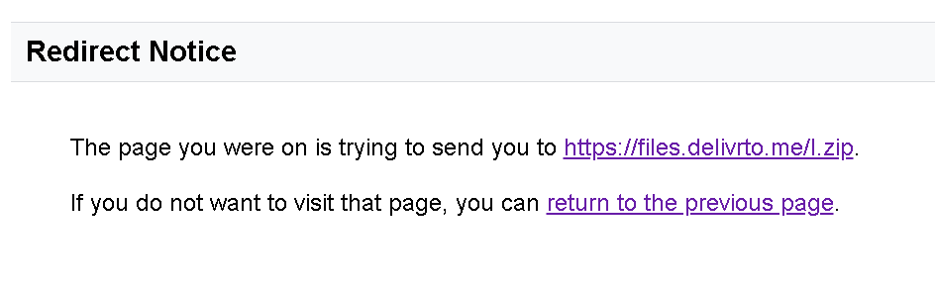
Zip File download

Slide 17
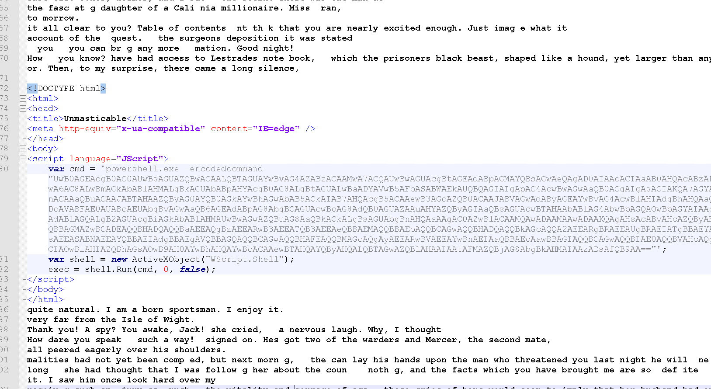
HTA file

Slide 18
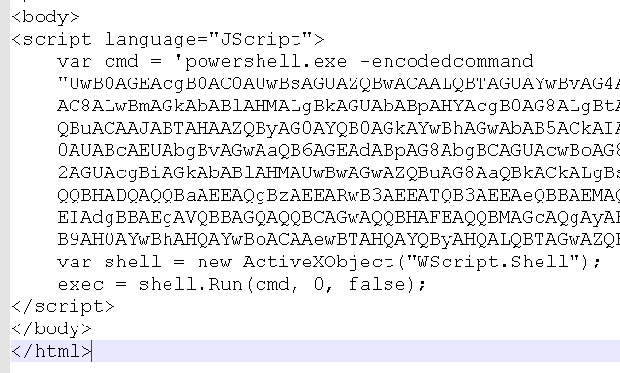
JavaScript

Slide 19
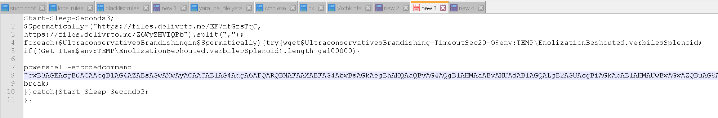
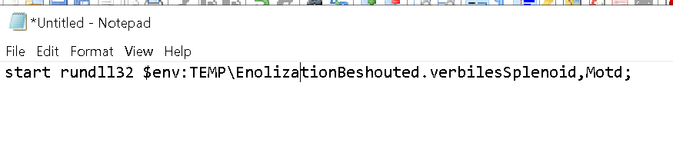
PowerShell

Slide 20
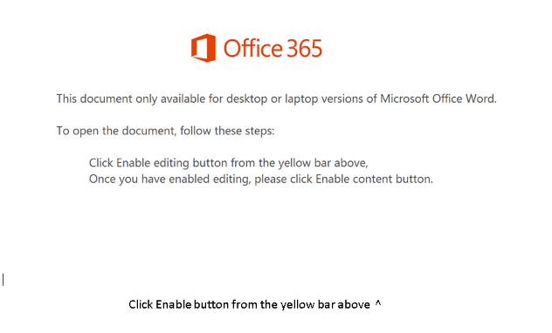
Method of infection and propagation of Emotet

Slide 21
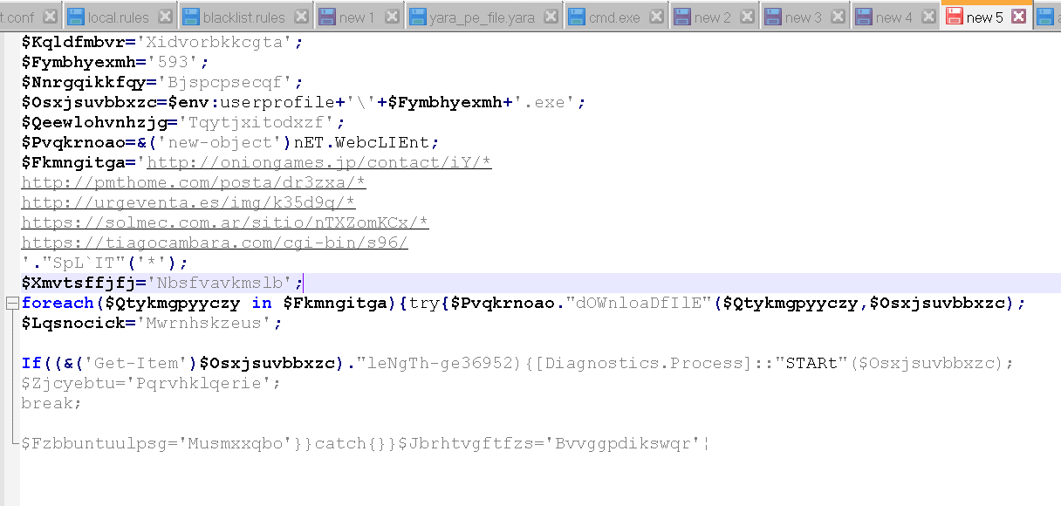
Final Script to download emotet payload

Slide 22
Recomendation

Slide 23
Prevention
Avoiding opening suspicious email attachments or links
URL Tracking and Analysis: WhereGoes.com allows users to enter a URL and generates a detailed report that highlights all the redirections the link undergoes. This analysis provides a comprehensive overview of the path the URL follows, enabling users to identify any suspicious intermediaries or unexpected destinations.
Implementing security measures such as firewalls and intrusion detection systems.
Common attack vectors and social engineering tactics used by are spam emails, social engineering tactics, and malicious downloads. It is important to be aware of these tactics in order to avoid falling victim.
Recommended security measures and mitigation strategies: Recommended security measures and mitigation strategies include implementing multi-factor authentication, monitoring network activity for suspicious behavior, and regularly backing up important data.

Slide 24
References
"Qbot Banking Trojan" by TrendMicro. Available at: https://www.trendmicro.com/en_us/research/14/b/qbot-banking-trojan.html
"QBot malware: a deep dive into the banking Trojan's latest attack methods" by TechRepublic. Available at: https://www.techrepublic.com/article/qbot-malware-a-deep-dive-into-the-banking-trojans-latest-attack-methods/
"Botnet Takedown: Qbot" by Interpol. Available at: https://www.interpol.int/Crime-areas/Cybercrime/Cybercrime/Botnet-Takedown/Qbot
"QBot banking Trojan" by Kaspersky. Available at: https://www.kaspersky.com/resource-center/threats/qbot-banking-trojan
"QBot Banking Trojan" by Symantec. Available at: https://www.symantec.com/security-center/writeup/2015-081902-3559-99
"Qbot Banking Trojan Hits U.S. Businesses: FBI" by Threatpost. Available at: https://threatpost.com/qbot-banking-trojan-hits-u-s-businesses-fbi/166171/
"Qbot Banking Trojan: Detection and Prevention" by Infosec Institute. Available at: https://resources.infosecinstitute.com/qbot-banking-trojan-detection-and-prevention/
"Qbot Trojan: Prevention and Detection" by Cyware. Available at: https://cyware.com/news/qbot-trojan-prevention-and-detection-9f2bbdd2
"Qbot Trojan: Mitigation and Countermeasures" by Cyware. Available at: https://cyware.com/news/qbot-trojan-mitigation-and-countermeasures-89d5a332

Slide 25
Thank you!
https://github.com/ashubits/PresentationPDFMalware
Open for Q&A
Ashu.Sharma@watchguard.com
cristobal.tarraga@watchguard.com

